Slide 1

Slide 10- <number>

Slide 2
Chapter 14
Functional Dependencies and Normalization for Relational Databases
Copyright © 2007 Ramez Elmasri and Shamkant B. Navathe

Slide 3
1 Informal Design Guidelines for Relational Databases (1)
What is relational database design?
  The grouping of attributes to form "good" relation schemas
Two levels of relation schemas
  The logical "user view" level
  The storage "base relation" level
Design is concerned mainly with base relations
What are the criteria for "good" base relations?
Slide 10- <number>

Slide 4
Informal Design Guidelines for Relational Databases (2)
We first discuss informal guidelines for good relational design
Then we discuss formal concepts of functional dependencies and normal forms
  - 1NF (First Normal Form)
  - 2NF (Second Normal Form)
  - 3NF (Third Normal Form)
  - BCNF (Boyce-Codd Normal Form)
Additional types of dependencies, further normal forms, relational design algorithms by synthesis are discussed in Chapter 11
Slide 10- <number>

Slide 5
1.1 Semantics of the Relation Attributes
GUIDELINE 1: Informally, each tuple in a relation should represent one entity or relationship instance. (Applies to individual relations and their attributes).
  Attributes of different entities (EMPLOYEEs, DEPARTMENTs, PROJECTs) should not be mixed in the same relation
  Only foreign keys should be used to refer to other entities
  Entity and relationship attributes should be kept apart as much as possible.
Bottom Line: Design a schema that can be explained easily relation by relation. The semantics of attributes should be easy to interpret.
Slide 10- <number>

Slide 6
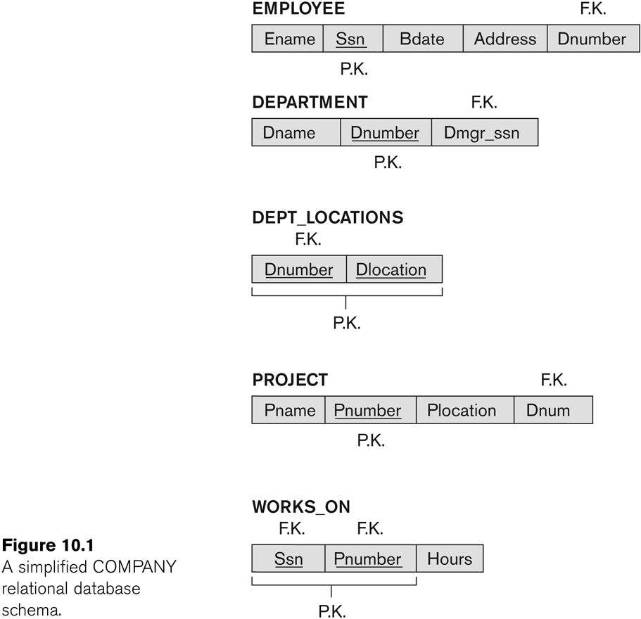
Figure 10.1 A simplified COMPANY relational database schema
Slide 10- <number>

Slide 7
1.2 Redundant Information in Tuples and Update Anomalies
Information is stored redundantly
  Wastes storage
  Causes problems with update anomalies
    Insertion anomalies
    Deletion anomalies
    Modification anomalies
Slide 10- <number>

Slide 8
EXAMPLE OF AN UPDATE ANOMALY
Consider the relation:
  EMP_PROJ(Emp#, Proj#, Ename, Pname, No_hours)
Update Anomaly:
  Changing the name of project number P1 from “Billing” to “Customer-Accounting” may cause this update to be made for all 100 employees working on project P1.
Slide 10- <number>

Slide 9
EXAMPLE OF AN INSERT ANOMALY
Consider the relation:
  EMP_PROJ(Emp#, Proj#, Ename, Pname, No_hours)
Insert Anomaly:
  Cannot insert a project unless an employee is assigned to it.
Conversely
  Cannot insert an employee unless an he/she is assigned to a project.
Slide 10- <number>

Slide 10
EXAMPLE OF AN DELETE ANOMALY
Consider the relation:
  EMP_PROJ(Emp#, Proj#, Ename, Pname, No_hours)
Delete Anomaly:
  When a project is deleted, it will result in deleting all the employees who work on that project.
  Alternately, if an employee is the sole employee on a project, deleting that employee would result in deleting the corresponding project.
Slide 10- <number>

Slide 11
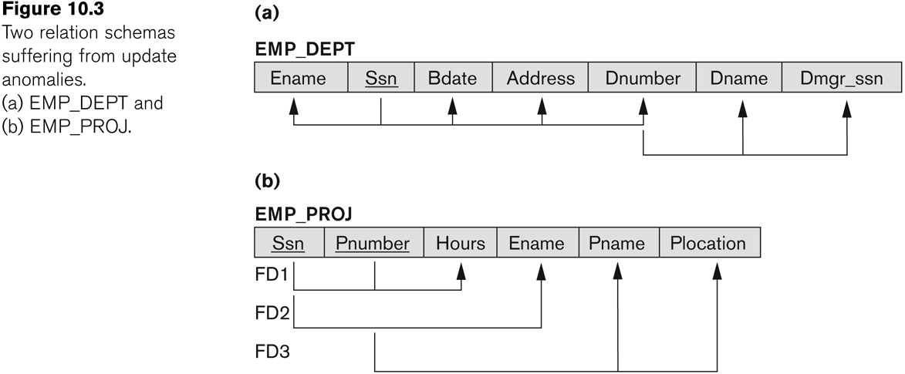
Figure 10.3 Two relation schemas suffering from update anomalies
Slide 10- <number>

Slide 12
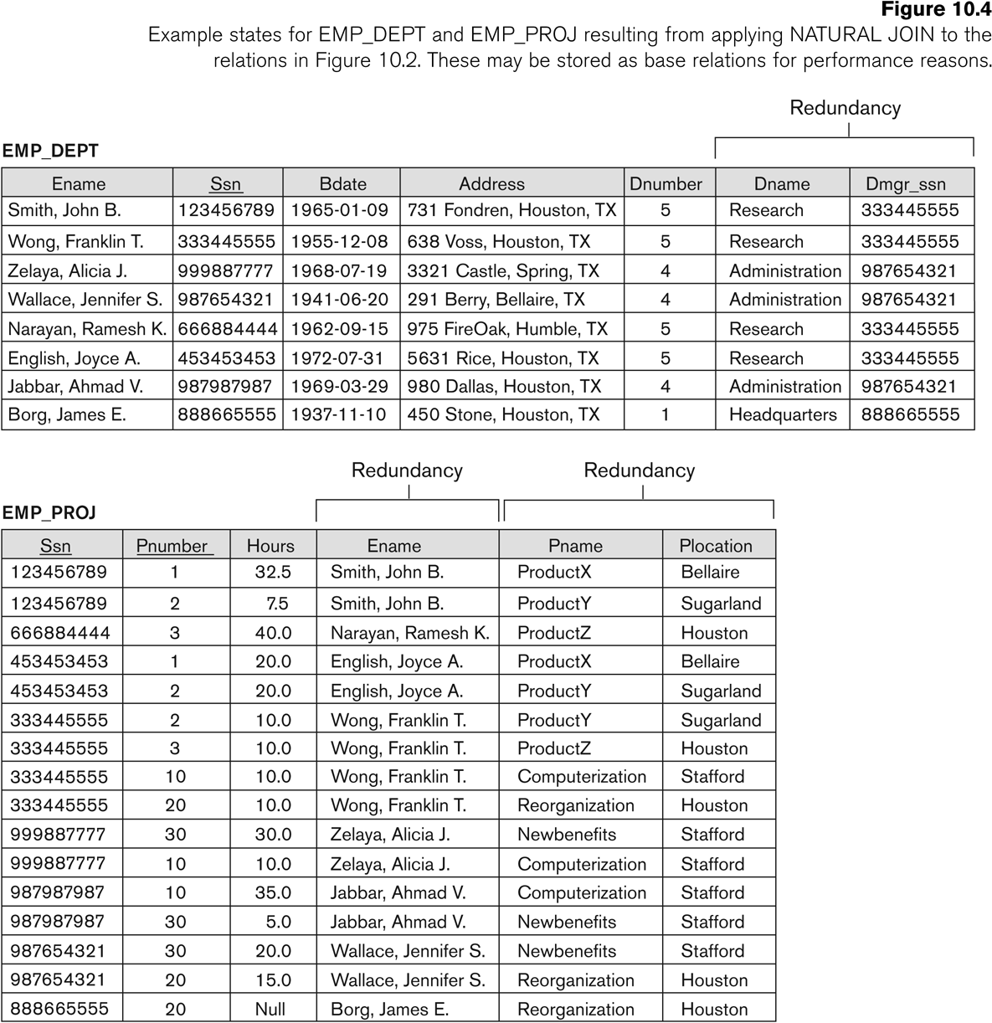
Figure 10.4 Example States for EMP_DEPT and EMP_PROJ
Slide 10- <number>

Slide 13
Guideline to Redundant Information in Tuples and Update Anomalies
GUIDELINE 2:
  Design a schema that does not suffer from the insertion, deletion and update anomalies.
  If there are any anomalies present, then note them so that applications can be made to take them into account.
Slide 10- <number>

Slide 14
1.3 Null Values in Tuples
GUIDELINE 3:
  Relations should be designed such that their tuples will have as few NULL values as possible
  Attributes that are NULL frequently could be placed in separate relations (with the primary key)
Reasons for nulls:
  Attribute not applicable or invalid(Student Visa Status)
  Attribute value unknown (may exist) (Emp DOB)
  Value known to exist, but unavailable (Phone No)
Slide 10- <number>

Slide 15
2.1 Functional Dependencies (1)
Functional dependencies (FDs)
  Are used to specify formal measures of the "goodness" of relational designs
  Are keys are used to define normal forms for relations
  Are constraints that are derived from the meaning and interrelationships of the data attributes
A set of attributes X functionally determines a set of attributes Y if the value of X determines a unique value for Y
Slide 10- <number>

Slide 16
Functional Dependencies (2)
Written as X -> Y; can be displayed graphically on a relation schema
Slide 10- <number>

Slide 17
Examples of FD constraints (1)
Social security number determines employee name
  SSN -> ENAME
Project number determines project name and location
  PNUMBER -> {PNAME, PLOCATION}
Employee ssn and project number determines the hours per week that the employee works on the project
  {SSN, PNUMBER} -> HOURS
Slide 10- <number>

Slide 18
Examples of FD constraints (2)
An FD is a property of the attributes in the schema R
The constraint must hold on every relation instance r(R)
If K is a key of R, then K functionally determines all attributes in R
  (since we never have two distinct tuples with t1[K]=t2[K])
Slide 10- <number>

Slide 19
2.2 Inference Rules for FDs (1)
Given a set of FDs F, we can infer additional FDs that hold whenever the FDs in F hold
Armstrong's inference rules:
  IR1. (Reflexive) If Y subset-of X, then X -> Y
  IR2. (Augmentation) If X -> Y, then XZ -> YZ
    (Notation: XZ stands for X U Z)
  IR3. (Transitive) If X -> Y and Y -> Z, then X -> Z
IR1, IR2, IR3 form a sound and complete set of inference rules
  These rules hold and all other rules that hold can be deduced from these
Slide 10- <number>

Slide 20
Inference Rules for FDs (2)
Some additional inference rules that are useful:
  Decomposition: If X -> YZ, then X -> Y and X -> Z
  Union: If X -> Y and X -> Z, then X -> YZ
  Psuedotransitivity: If X -> Y and WY -> Z, then WX -> Z
The last three inference rules, as well as any other inference rules, can be deduced from IR1, IR2, and IR3 (completeness property)
Slide 10- <number>

Slide 21
Full Functional Dependency
Full Functional Dependency:
  Only of relevance with composite determinants.
  This is the situation when it is necessary to use all the attributes of the composite determinant to identify its object uniquely.
Full Functional Dependencies
order# line# qty price
A001 001 10 200
A002 001 20 400
A002 002 25 800
A004 001 15 300
(Order#, line#) → qty
(Order#, line#) → price
Slide 10- <number>

Slide 22
Partial Functional Dependency
Partial Functional Dependency:
  This is the situation that exists if it is necessary to only use a subset of the attributes of the composite determinant to identify its object uniquely.
Example:
Full Functional Dependencies
student# unit# room grade
9900100 A01 TH224 2
9900010 A01 TH224 14
9901011 A02 JS075 3
9900001 A01 TH224 16
(student#, unit#) → grade
Partial Functional Dependencies
unit# → room
Slide 10- <number>

Slide 23
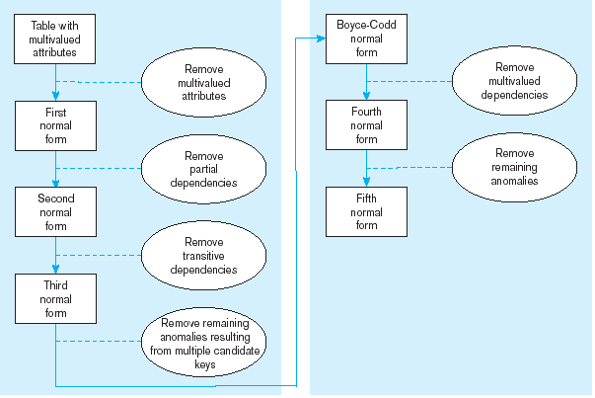
Steps in normalization

Slide 24
3 Normal Forms Based on Primary Keys
3.1 Normalization of Relations
3.2 Practical Use of Normal Forms
3.3 Definitions of Keys and Attributes Participating in Keys
3.4 First Normal Form
3.5 Second Normal Form
3.6 Third Normal Form
Slide 10- <number>

Slide 25
3.1 Normalization of Relations (1)
Normalization:
  The process of decomposing unsatisfactory "bad" relations by breaking up their attributes into smaller relations
Normal form:
  Condition using keys and FDs of a relation to certify whether a relational schema is in a particular normal form
Slide 10- <number>

Slide 26
Normalization of Relations (2)
2NF, 3NF, BCNF
  based on keys and FDs of a relational schema
4NF
  based on keys, multi-valued dependencies : MVDs; 5NF based on keys, join dependencies : JDs (Chapter 11)
Additional properties may be needed to ensure a good relational design (lossless join, dependency preservation; Chapter 11)
Slide 10- <number>

Slide 27
3.2 Practical Use of Normal Forms
Normalization is carried out in practice so that the resulting designs are of high quality and meet the desirable properties
The database designers need not to normalize to the highest possible normal form
  (usually up to 3NF, BCNF or 4NF)
Denormalization:
  The process of storing the join of higher normal form relations as a base relation—which is in a lower normal form
Slide 10- <number>

Slide 28
3.2 First Normal Form
Disallows
  composite attributes
  multivalued attributes
  nested relations; attributes whose values for an individual tuple are non-atomic
Slide 10- <number>

Slide 29

Figure 10.8 Normalization into 1NF
Slide 10- <number>

Slide 30
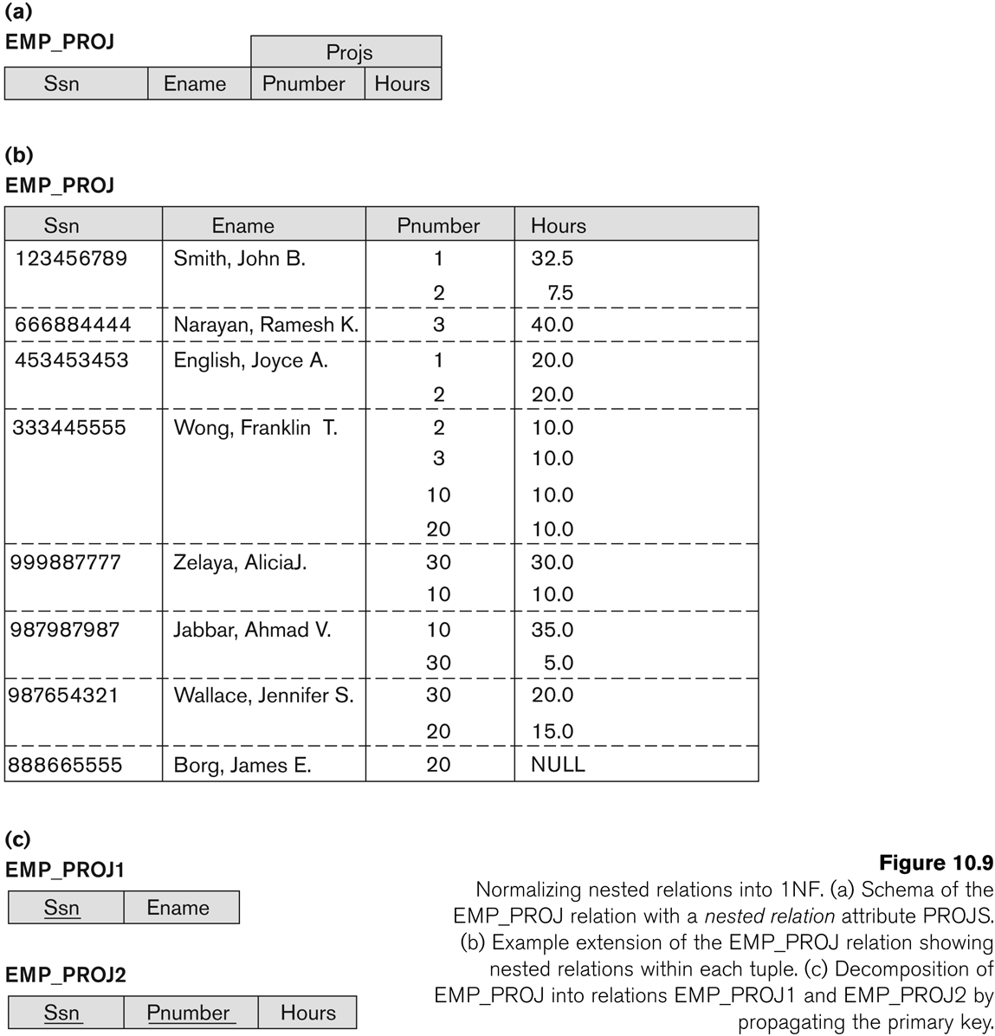
Figure 10.9 Normalization nested relations into 1NF
Slide 10- <number>

Slide 31
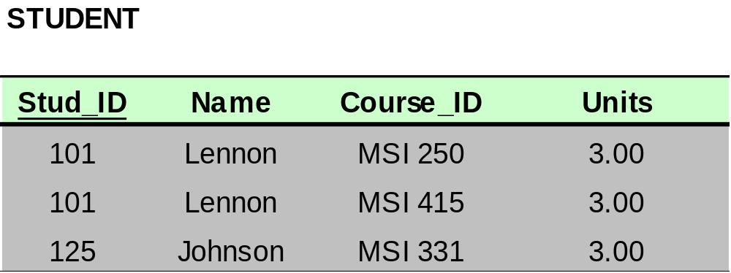
Another Example: Bringing a Relation to 1NF
Option 1: Make a determinant of the repeating group (or the multivalued attribute) a part of the primary key.
Composite Primary Key
Slide 10- <number>

Slide 32

Another Example: Bringing a Relation to 1NF
Option 2: Remove the entire repeating group from the relation.
  Create another relation which would contain all the attributes of the repeating group, plus the primary key from the first relation.
  In this new relation, the primary key from the original relation and the determinant of the repeating group will comprise a primary key.
Slide 10- <number>

Slide 33
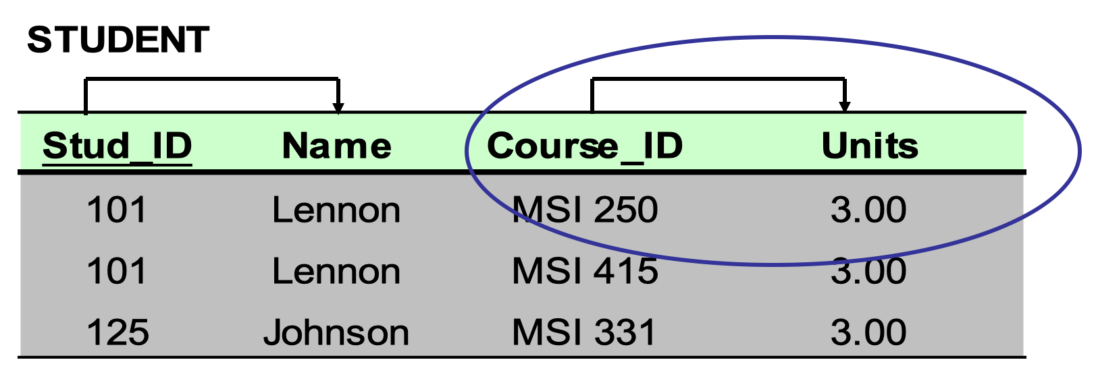
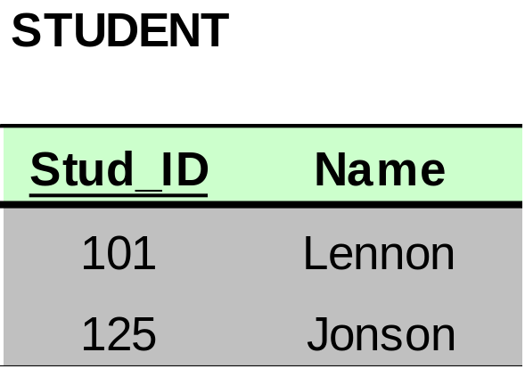
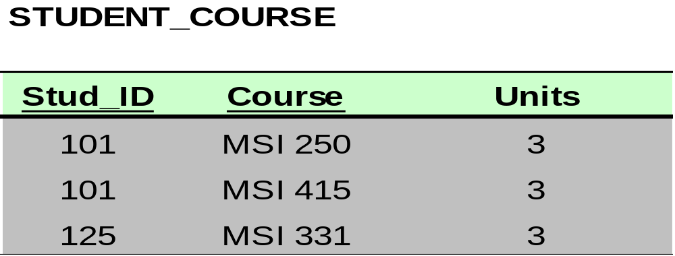
Another Example: Bringing a Relation to 1NF
Slide 10- <number>

Slide 34
3.3 Second Normal Form (1)
Uses the concepts of FDs, primary key
Definitions
  Prime attribute: An attribute that is member of the primary key K
  Full functional dependency: an FD Y -> Z where removal of any attribute from Y means the FD does not hold any more
Examples:
  {SSN, PNUMBER} -> HOURS is a full FD since neither SSN -> HOURS nor PNUMBER -> HOURS hold
  {SSN, PNUMBER} -> ENAME is not a full FD (it is called a partial dependency ) since SSN -> ENAME also holds
Slide 10- <number>

Slide 35
Second Normal Form (2)
A relation schema R is in second normal form (2NF) if every non-prime attribute A in R is fully functionally dependent on the primary key
R can be decomposed into 2NF relations via the process of 2NF normalization
Slide 10- <number>

Slide 36

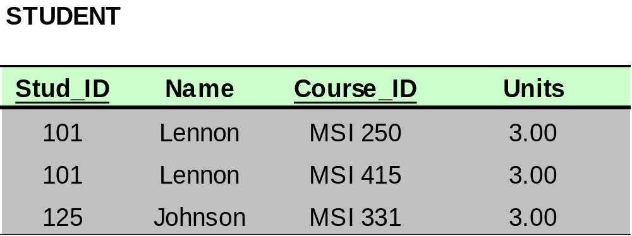
Bringing a Relation to 2NF
Composite Primary Key
Slide 10- <number>

Slide 37
Bringing a Relation to 2NF
Goal: Remove Partial Dependencies
Partial Dependencies
Composite Primary Key
Slide 10- <number>

Slide 38
Bringing a Relation to 2NF
Remove attributes that are dependent on the part but not the whole of the primary key from the original relation.
For each partial dependency, create a new relation, with the corresponding part of the primary key from the original as the primary key.
Slide 10- <number>

Slide 39

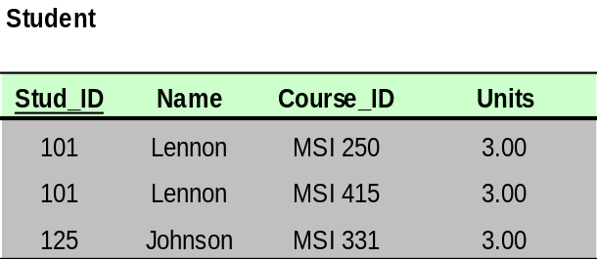
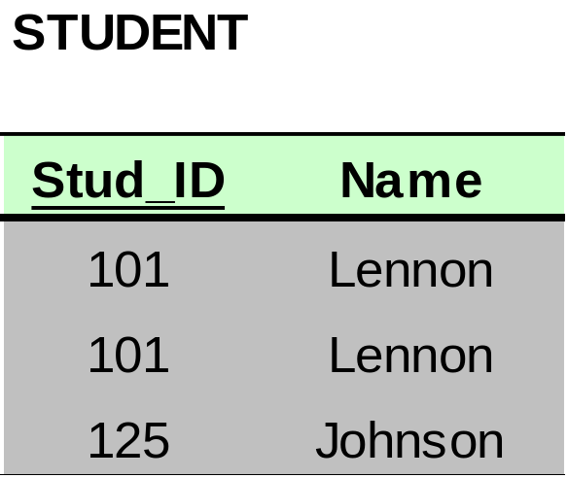
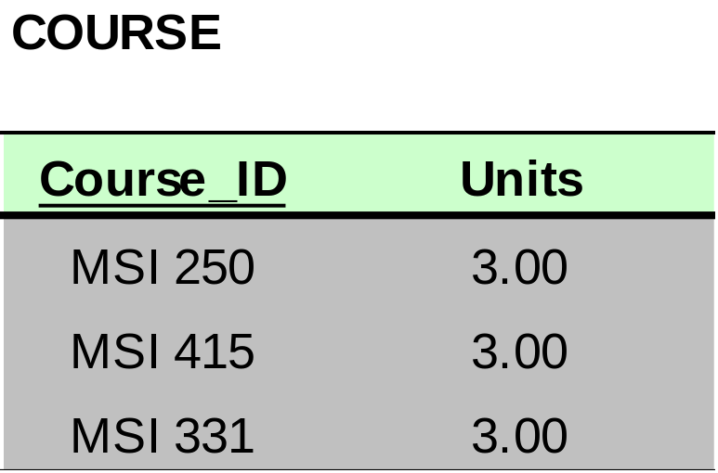
Bringing a Relation to 2NF
Slide 10- <number>

Slide 40
3.4 Third Normal Form (1)
Definition:
  Transitive functional dependency: an FD X -> Z that can be derived from two FDs X -> Y and Y -> Z
Examples:
  SSN -> DMGRSSN is a transitive FD
    Since SSN -> DNUMBER and DNUMBER -> DMGRSSN hold
  SSN -> ENAME is non-transitive
    Since there is no set of attributes X where SSN -> X and X -> ENAME
Slide 10- <number>

Slide 41
Third Normal Form (2)
A relation schema R is in third normal form (3NF) if it is in 2NF and no non-prime attribute A in R is transitively dependent on the primary key
R can be decomposed into 3NF relations via the process of 3NF normalization
NOTE:
  If X -> Y and Y -> Z, with X as the primary key, the issue arises only when Y is not a candidate key
    If Y is a candidate key, there is no problem of the transitive dependency
Slide 10- <number>

Slide 42
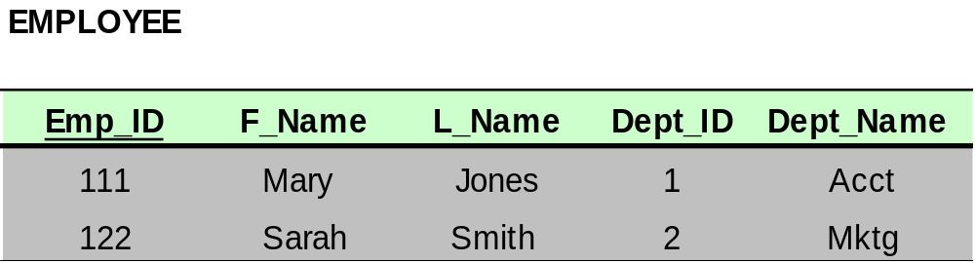
Bringing a Relation to 3NF
Goal: Get rid of Transitive Dependencies (TD)
  Dept_ID is not a candidate Key hence TD exists
Transitive Dependency
Slide 10- <number>

Slide 43
Bringing a Relation to 3NF
Remove the attributes, which are dependent on a non-key attribute, from the original relation.
For each transitive dependency,
  create a new relation with the non-key attribute which is a determinant in the transitive dependency as a primary key,
  and the dependent non-key attribute as a dependent.
Slide 10- <number>

Slide 44
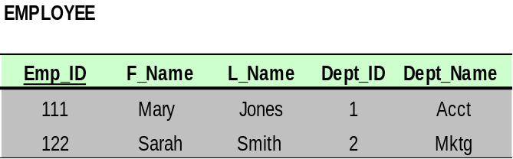
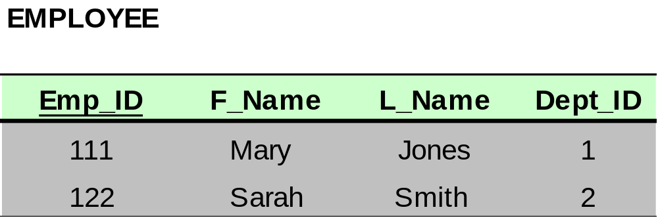
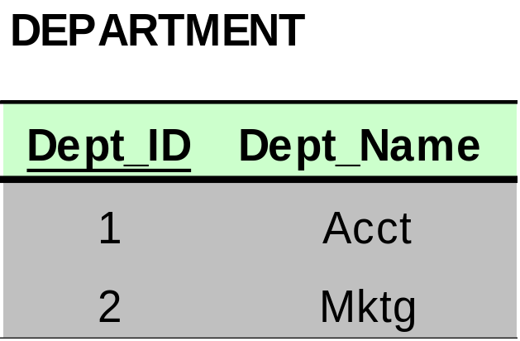
Bringing a Relation to 3NF
Slide 10- <number>

Slide 45
Recap - Stages of Normalisation
Unnormalised
(UDF)
Remove repeating groups
First normal form
(1NF)
Remove partial dependencies
Second normal form
(2NF)
Remove transitive dependencies
Third normal form
(3NF)

Slide 46
Normal Forms Defined Informally
1st normal form
  All attributes depend on the key
2nd normal form
  All attributes depend on the whole key
3rd normal form
  All attributes depend on nothing but the key
Slide 10- <number>

Slide 47
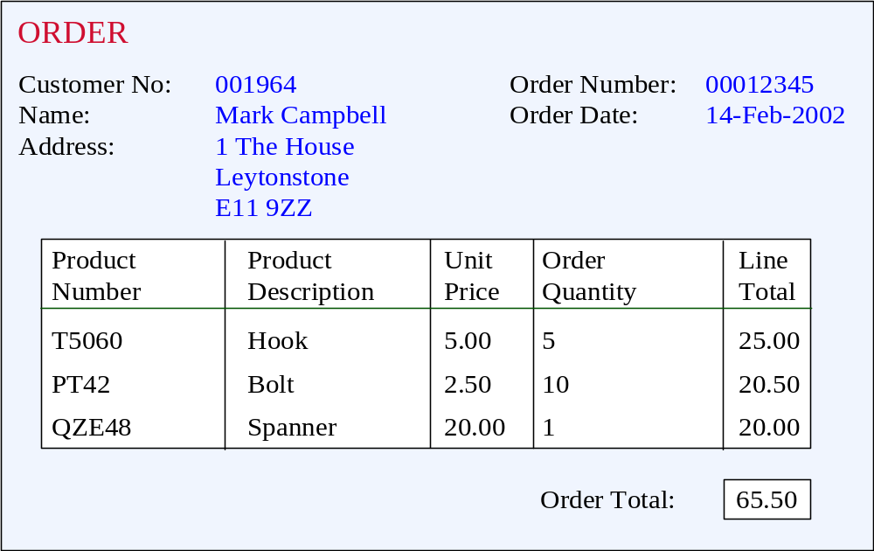
Unnormalised Normal Form (UNF)
ORDER (order-no, order-date, cust-no, cust-name, cust-add,
(prod-no, prod-desc, unit-price, ord-qty, line-total)*, order-total

Slide 48
First Normal Form (1NF)
Definition: A relation is in 1NF if, and only if, all its underlying attributes contain atomic values only.
Remove repeating groups into a new relation
A repeating group is shown by a pair of brackets within the relational schema.
ORDER (order-no, order-date, cust-no, cust-name, cust-add,
(prod-no, prod-desc, unit-price, ord-qty, line-total)*, order-total

Slide 49
Steps from UNF to 1NF:
Remove the outermost repeating group (and any nested repeated groups it may contain) and create a new relation to contain it.
Add to this relation a copy of the PK of the relation immediately enclosing it.
Name the new entity (appending the number 1 to indicate 1NF)
Determine the PK of the new entity
Repeat steps until no more repeating groups.

Slide 50
Example - UNF to 1NF
ORDER (order-no, order-date, cust-no, cust-name, cust-add,
(prod-no, prod-desc, unit-price, ord-qty, line-total)*, order-total
1. Remove the outermost repeating group (and any nested repeated groups it may contain) and create a new relation to contain it. (rename original to indicate 1NF)
ORDER-1 (order-no, order-date, cust-no, cust-name, cust-add, order-total
(prod-no, prod-desc, unit-price, ord-qty, line-total)
2. Add to this relation a copy of the PK of the relation immediately enclosing it.
ORDER-1 (order-no, order-date, cust-no, cust-name, cust-add, order-total
(order-no, prod-no, prod-desc, unit-price, ord-qty, line-total)
3. Name the new entity (appending the number 1 to indicate 1NF)
ORDER-LINE-1 (order-no, prod-no, prod-desc, unit-price, ord-qty, line-total)
4. Determine the PK of the new entity
ORDER-LINE-1 (order-no, prod-no, prod-desc, unit-price, ord-qty, line-total)

Slide 51
Second Normal Form (2NF)
Definition: A relation is in 2NF if and only if, it is in 1NF and every non-key attribute is fully dependent on the primary key.
Remove partial functional dependencies into a new relation

Slide 52
Steps from 1NF to 2NF:
Remove the offending attributes that are only partially functionally dependent on the composite key, and place them in a new relation.
Add to this relation a copy of the attribute(s) which are the determinants of these offending attributes. These will automatically become the primary key of this new relation.
Name the new entity (appending the number 2 to indicate 2NF)
Rename the original entity (ending with a 2 to indicate 2NF)

Slide 53
Example - 1NF to 2NF
ORDER-LINE-1 (order-no, prod-no, prod-desc, unit-price, ord-qty, line-total)
1. Remove the offending attributes that are only partially functionally dependent on the composite key, and place them in a new relation.
ORDER-LINE-1 (order-no, prod-no, ord-qty, line-total)
(prod-desc, unit-price)
2. Add to this relation a copy of the attribute(s) which determines these offending attributes. These will automatically become the primary key of this new relation..
ORDER-LINE-1 (order-no, prod-no, ord-qty, line-total)
(prod-no, prod-desc, unit-price)
3. Name the new entity (appending the number 2 to indicate 2NF)
PRODUCT-2 (prod-no, prod-desc, unit-price)
4. Rename the original entity (ending with a 2 to indicate 2NF)
ORDER-LINE-2 (order-no, prod-no, ord-qty, line-total)

Slide 54
Third Normal Form (3NF)
Definition: A relation is in 3NF if and only if, it is in 2NF and every non-key attribute is non-transitively dependent on the primary key.

Slide 55
Steps from 2NF to 3NF:
Remove the offending attributes that are transitively dependent on non-key attribute(s), and place them in a new relation.
Add to this relation a copy of the attribute(s) which are the determinants of these offending attributes. These will automatically become the primary key of this new relation.
Name the new entity (appending the number 3 to indicate 3NF)
Rename the original entity (ending with a 3 to indicate 3NF)

Slide 56
Example - 2NF to 3NF
ORDER-2 (order-no, order-date, cust-no, cust-name, cust-add, order-total
1. Remove the offending attributes that are transitively dependent on non-key attributes, and place them in a new relation.
ORDER-2 (order-no, order-date, cust-no, order-total
(cust-name, cust-add )
2. Add to this relation a copy of the attribute(s) which determines these offending attributes. These will automatically become the primary key of this new relation..
ORDER-2 (order-no, order-date, cust-no, order-total
(cust-no, cust-name, cust-add )
3. Name the new entity (appending the number 3 to indicate 3NF)
CUSTOMER-3 (cust-no, cust-name, cust-add )
4. Rename the original entity (ending with a 3 to indicate 3NF)
ORDER-3 (order-no, order-date, cust-no, order-total

Slide 57
Example - Relations in 3NF
ORDER-3 (order-no, order-date, cust-no, order-total
CUSTOMER-3 (cust-no, cust-name, cust-add )
PRODUCT-2 (prod-no, prod-desc, unit-price)
ORDER-LINE-2 (order-no, prod-no, ord-qty, line-total)
prod-no
order-no
PRODUCT
ORDER
shows
places
contains
cust-no
order-no, prod-no
CUSTOMER
ORDER-LINE

Slide 58
Example - Relations in 3NF
ORDER-3 (order-no, order-date, cust-no, order-total
CUSTOMER-3 (cust-no, cust-name, cust-add )
PRODUCT-2 (prod-no, prod-desc, unit-price)
ORDER-LINE-2 (order-no, prod-no, ord-qty, line-total)
prod-no
order-no
PRODUCT
ORDER
shows
places
placed by
contains
belongs to
cust-no
order-no, prod-no
CUSTOMER
part of
ORDER-LINE

Slide 59
Extra Exercises
Slide 10- <number>

Slide 60
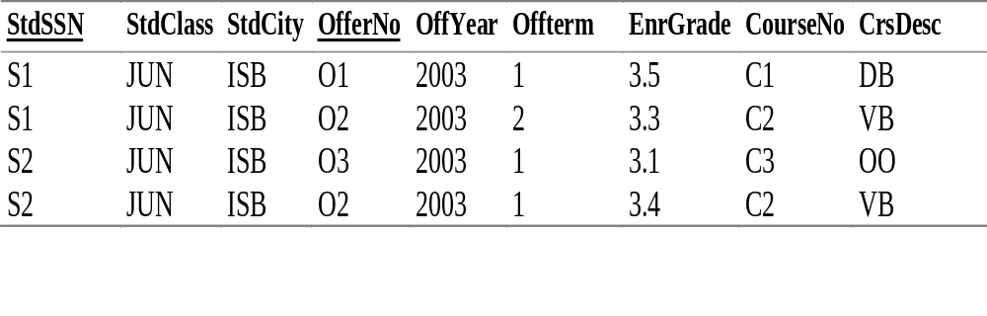
Example 2: University Database Table
Notes:
Big University Database Table:
- Table 7-1 except for omission of two columns (StdCity and OffTerm)

Slide 61
Example 2: University Database Table
StdSSN → StdCity, StdClass
OfferNo → OffTerm, OffYear, CourseNo, CrsDesc
CourseNo → CrsDesc
StdSSN, OfferNo → EnrGrade
Notes:
Big University Database Table:
- Table 7-1 except for omission of two columns (StdCity and OffTerm)

Slide 62
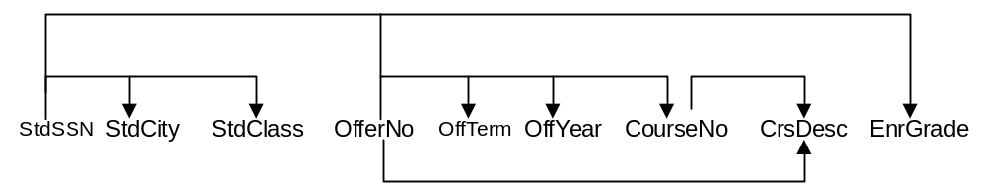
FD Diagrams and Lists
StdSSN → StdCity, StdClass
OfferNo → OffTerm, OffYear, CourseNo, CrsDesc
CourseNo → CrsDesc
StdSSN, OfferNo → EnrGrade
Notes:
FD diagram:
- 8.2 of textbook chapter 8
- See related FDs (same LHS) by line height
- Useful for small sets of FDs
- Unwieldy for large sets of FDs
FD list:
- Group by LHS
- Shortcut notation: X -> Y, Z is a shortcut for X -> Y and X -> Z
Compound LHS:
- Similar to a combined PK
- Compound LHS is not a shortcut (as is a compound RHS)
- Combination of StdSSN and OfferNo determine EnrGrade (not either column alone)
Minimality:
- LHS must be minimal
- Cannot remove columns from LHS without making the FD invalid
- Usually non minimal LHS is not a problem: important that LHS does not have
extraneous columns
- Properly known as full functional dependence: minimal LHS makes full functional dep.

Slide 63
Problems
Anomalies:
  - PK: combination of StdSSN and OfferNo
  - Insert: cannot insert a new student without enrolling in an offering (OfferNo part of PK)
  - Update: change a course description; change every enrollment of the course
  - Delete: remove third row; lose information about course C3
Table has obvious redundancies
Easier to query: no joins
More difficult to change: can work around problems (dummy PK) but tedious to do

Slide 64
Normalization
Process of removing unwanted redundancies
Apply normal forms
  Identify FDs
  Determine whether FDs meet normal form
  Split the table to meet the normal form if there is a violation
Notes:
Normal form:
- Rule about allowable pattern of FDs (1NF through BCNF)
- Higher normal forms are not rules about FDs: more difficult to understand and use
- Most important part is to record FDs: CASE tool can perform normalization
- Check FDs to see if they violate the pattern permitted in the normal form
Split table
- Smaller tables do not violate the normal form
- Smaller tables should not lose information contained in the larger table
Difficulty:
- Normalization is easy to apply to small tables with simple dependency structures
- Use CASE tool for large databases and tables with complex dependency structures

Slide 65
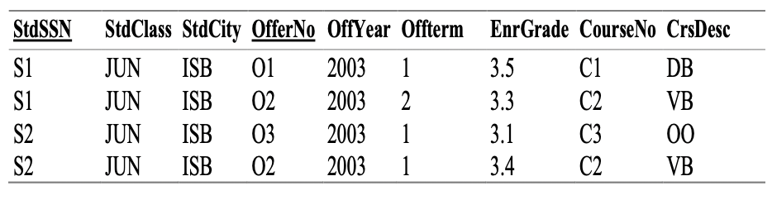
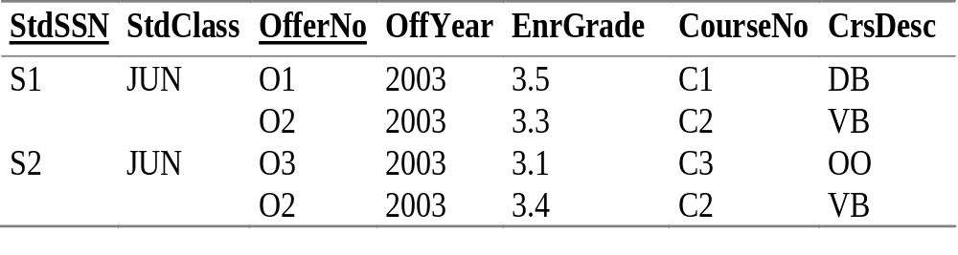
1NF
No repeating groups: flat rows
Notes:
Big university database table is not normalized
- Not in 1NF
- S1 row has repeating values (O1 and O2)
- S2 row has repeating values (O3 and O2)
Convert to 1NF:
- Flatten rows
- Split each repeating group into a separate row
- Repeat the implied values in the new rows:
- S1 JUN for row two with O2 2000 3.3 C2 VB
- S2 JUN for row four with O2 2000 3.4 C2 VB

Slide 66
Combined Definition of 2NF/3NF
Key column: candidate key or part of candidate key
Analogy to the traditional justice oath
Every non key depends on a key, the whole key, and nothing but the key
Usually taught as separate definitions
Notes:
Candidate key:
- Unique
- Minimal: no extraneous columns without losing uniqueness property
- Can have multiple candidate keys per table
Key column:
- A candidate key by itself
- Part of a combined CK
- Nonkey: a column that is not a key column
Combined definition:
- Analogy to traditional justice oath
- So help me: Ted Codd (father of relational databases)
- Usually taught as separate definitions for simplicity

Slide 67
2NF
Every nonkey column depends on a whole key, not part of a key
Violations
  Part of key → nonkey
  Violations only for combined keys
Notes:
First of combined 2NF/3NF definition: dependent on the whole key
Violation:
- Part of a key determines a non key
- If FDs for a table contain such an FD, split the table

Slide 68
2NF Example
Many violations for the big university database table
  StdSSN → StdCity, StdClass
  OfferNo → OffTerm, OffYear, CourseNo, CrsDesc
Splitting the table
  UnivTable1 (StdSSN, StdCity, StdClass)
  UnivTable2 (OfferNo, OffTerm, OffYear, CourseNo, CrsDesc)
Notes:
Violating FDs:
- All FDs violate except StdSSN, OfferNo -> EnrGrade
- StdSSN: part of a key (not the entire key)
- OfferNo: part of a key (not the entire key)
Splitting:
- Place each FD group in a separate table
- UnivTable1: StdSSN group
- UnivTable2: OfferNo group
- UnivTable3: StdSSN, OfferNo group
- No violations among new tables
- CourseNo -> CrsDesc (CourseNo is not part of a key)
- This FD violates 3NF, not 2NF
Splitting process:
- Recover original table with natural join
- Not lose any FDs: all FDs are derivable
- Books on normalization theory explain criteria: theory not important here

Slide 69
3NF
Every nonkey column depends only on a key not on non key columns
Violations: Nonkey → Nonkey
Alterative formulation
  No transitive FDs
  A → B, B → C then A → C
  OfferNo → CourseNo, CourseNo → CrsDesc then OfferNo → CrsDesc
Notes:
Second part of combined 2NF/3NF definition: nothing but the key
Violation:
- Non key determines a non key
- If FDs for a table contain such an FD, split the table
Alternative formulation:
- No transitive FDs
- Law of transitivity: A < B, B < C then A < C
- Transitivity applies to FDs
- Not the preferred definition of 3NF: should not write down transitively derived FDs
- Simple synthesis procedure for BCNF

Slide 70
3NF Example
One violation in UnivTable2
  CourseNo → CrsDesc
Splitting the table
  UnivTable2-1 (OfferNo, OffTerm, OffYear, CourseNo)
  UnivTable2-2 (CourseNo, CrsDesc)
Notes:
Violating FDs:
- CourseNo is non key
- Alternatively, OfferNo -> CrsDesc is a transitively derived FD
Splitting UnivTable2:
- Arrange by LHS
- UnivTable2-2: CourseNo is the PK

Slide 71

Example 2 – Do it Yourself

Slide 72
Example 3
Slide 10- <number>

Slide 73
Further Example
Primary Key (Supplier#, Part#)
S#
Status
City
P#
Qty
S1
20
London
P1
1600
S1
20
London
P2
2000
S2
10
Paris
P2
500
S3
20
London
P3
3000
Insert - cannot insert the fact that a supplier is located in a particular city until supplier supplies at least one part
Delete - delete the value P3, and we also lose the information that S3 is located in London
Update - S1 appears in the table more than once, and we must change all of them -- Possibility of producing an inconsistent result.

Slide 74
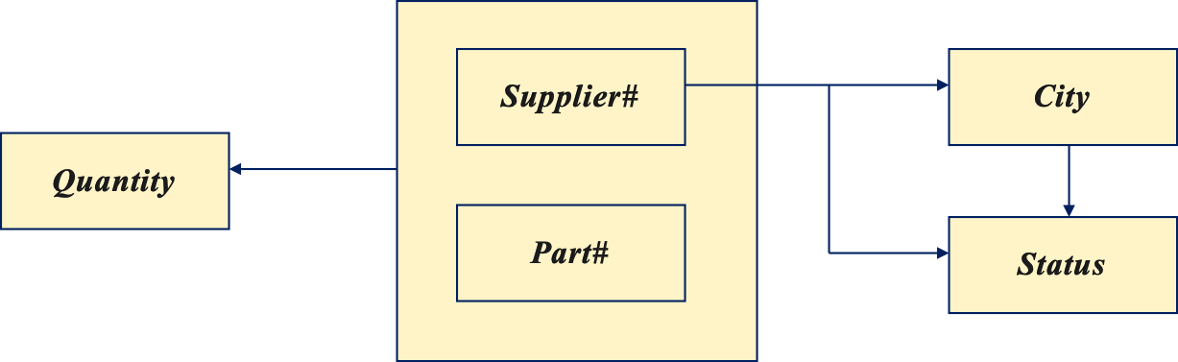
Example Scenario
By analyzing a given relation, we can identify some dependencies between its attributes.
In principle, we want to make attributes independent of each other as far as possible, so that updating one attribute will have no impact on the others.

Slide 75
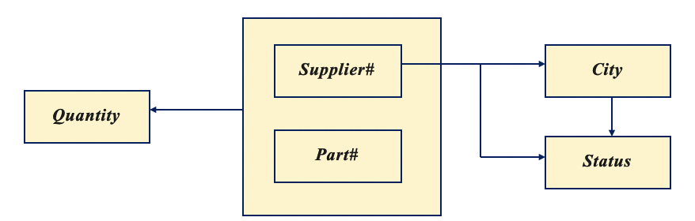
2NF Example
Table {S#, STATUS, CITY, P#, QTY}
  Primary key: {S#, P#}
  {S#} -> {CITY}, {CITY} -> {STATUS}
Test of 2NF
  {S#} -> {STATUS, CITY}: partial dependencies.
  Table is in 1NF, but not in 2NF.
Decomposition:
  Tablee {S#, STATUS, CITY}
  SP {S# (FK: references Tablee), P#, QTY}

Slide 76
2NF-Solution to Problems
The solution is to replace the relation by two new relations (called One and Two)
One: Primary Key (Supplier#)
Two: Primary Key (Supplier#, Part#)
Supplier#
Status
City
Supplier#
Part#
Quantity
S1
20
London
S1
P1
1600
S2
10
Paris
S1
P2
2000
S3
20
London
S2
P2
500
S3
P3
3000
This revised structure overcomes all the problems sketched earlier, but:
  Insert - cannot insert the fact that a particular city has a status until a supplier is actually located in that city.
  Delete - delete the value S2, and we also lose the information that Paris has the status value 10.
  Update - Status value 20 appears in the table more than once.

Slide 77
Third Normal Form (3NF)
A table is in 3NF if and only if
  it is in 2NF and
  every non-key attribute is non-transitively dependent on the primary key.
3NF prohibits transitive dependencies.
If A -> B and B -> C, C is transitively dependent on A.

Slide 78
3NF Example
Tablee {S#, STATUS, CITY}
  Primary key: {S#}
  {S#} -> {CITY}, {CITY} -> {STATUS}
Test of 3NF:
  {S#} -> {CITY} -> {STATUS}: transitive dependency
  Tablee is in 2NF, but not 3NF.
Decomposition:
  CS {CITY, STATUS}
  SC {S#, CITY (FK: references CS)}

Slide 79
Third Normal Form (3NF)
A relation is in 3NF if and only if it is 2NF and all non-key fields are mutually independent.
One: Primary Key (Supplier#)
Two: Primary Key (Supplier#, Part#)
Supplier#
Status
City
Supplier#
Part#
Quantity
S1
20
London
S1
P1
1600
S2
10
Paris
S1
P2
2000
S3
20
London
S2
P2
500
S3
P3
3000
Note: Relation Two is in 3NF (with only one non-key field), but relation One is not in 3NF because Status is dependent on City (both are non-key fields)

Slide 80
3NF - Converting 2NF into 3NF
We can now normalize relation One into two new relations (called three and four), which both are in 3NF.
Three: Primary Key (Supplier#)
Four: Primary Key (City)
Supplier#
City
S1
London
City
Status
London
20
S2
Paris
Paris
10
S3
London
Higher Normal Forms (e.g. 4NF and 5NF) do exist, but they are mainly of interest in academic societies rather than in the practical applications of database design.

Slide 81
Reference
Chapter # 14
Fundamentals of database systems
7th Edition
Slide 10- <number>

